Slide 1
AP US Government and Politics
Notes:
NOTE:
To change the image on this slide, select the picture and delete it. Then click the Pictures icon in the placeholder to insert your own image.

Slide 2
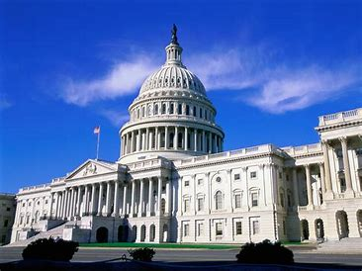
Course Description
AP U.S. Government and Politics is a year long course with a similar curriculum to a college introductory course in politics. This is a core requirement at many universities because classes like these teach students about not only politics, but the structure of the U.S. government. Students will learn to go beyond what they hear on the news and examine the values and principles of our democracy, a lifelong skill.
This year-long course will be organized around the following units of study:
Unit 1: Foundations of American Democracy (approximately 25 days)
Unit 2: Interactions Among Branches of Gov’t (~ 50 days)
Unit 3: Civil Liberties and Civil Rights (~ 24 days)
Unit 4: American Pol. Ideologies & Beliefs~20 days)
Unit 5: Political Participation (~20 days)

Slide 3
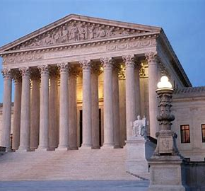
A Successful Student in AP US Government
In order to be successful in this course a student must be capable of a college level academic performance :
You will need strong reading and writing skills. The AP Exam requires the writing of four essays, including an argumentative essay.
You will also need strong critical thinking skills which will be used to analyze and interpret data, reflect upon current events, and develop arguments that relate to required Supreme Court cases and core foundational documents.
Finally, I hope you will learn to enjoy politics and gain a deeper understanding of the importance of government. All citizens need to be involved and committed to our constitution and the liberties protected by it, as well as the responsibilities demanded by this great document!

Slide 4
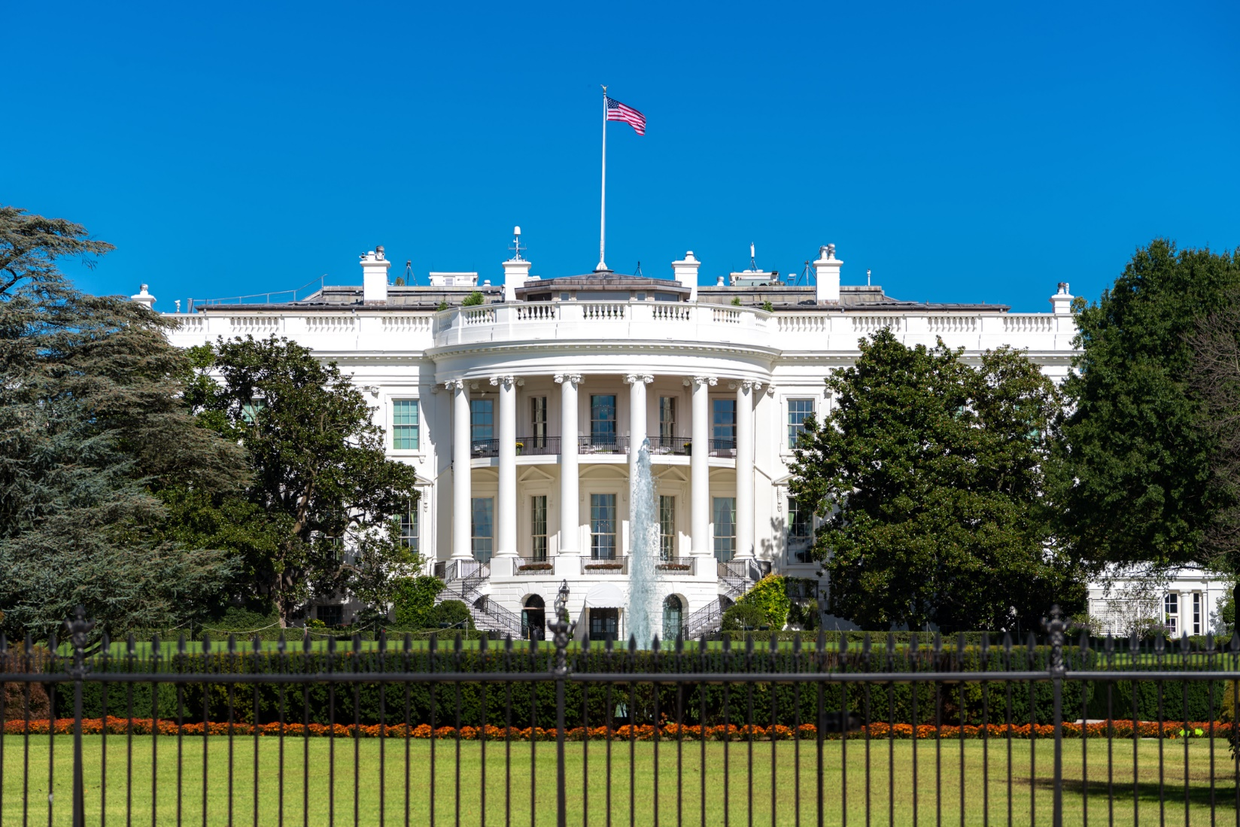
Expected Weekly Workload
Students will complete a summer assignment which will be assessed during the first week of the fall semester
Students will spend between 6 to 8 hours weekly reading the assigned textbook, primary source foundational documents, Supreme Court opinions and legal analysis, and academic articles
Students will complete research in preparation for simulations and debates, unit projects, and study guides related to the assigned reading
Students will be assessed through a multiple choice exam and free response questions for each unit

Slide 5
Exam Registration
All students will be expected to register for their AP exam by a deadline set forth by College Board. Each AP class has a unique join code that will be required for registration. You can register for the exam through the AP Classroom site which we will also use as for practice multiple choice questions and essay.

Slide 6
AP Exam and Exam Date
in May
You will take the AP US Government and Politics Exam on May 3, 2021.
The following chart provides a description of both multiple choice and essay questions.
Question Type | Number of Questions | Timing | Percentage of Total Score:
Multiple Choice | 55 | 80 minutes | 50%
Concept Application | 1 | 20 minutes (suggested) | 12.5%
Quantitative Analysis | 1 | 20 minutes (suggested) | 12 5%
Supreme Court Comparison | 1 | 20 minutes (suggested) | 12.5%
Argumentative Essay | 1 | 40 minutes (suggested) | 12.5%

